Slide 1
Vulnerable Groups
Health and Work – Week 8

Slide 2
Active Aging and Healthy Aging
Active Aging“… the process of optimizing opportunities for health, participation, and security in order to enhance quality of life as people age.” (WHO, 2002)
WHO Healthy Aging Strategy 2015-2030:
Healthy Aging is “...the process of developing and maintaining the functional ability that enables wellbeing in older age”. Functional ability is about having the capabilities that enable all people to be and do what they have reason to value.”
See: http://www.who.int/ageing/healthy-ageing/en/
WHO (2002) Active Aging: A Policy Framework, Geneva: WHO

Slide 3
Active Age Management (Ilmarinen,2012)
The eight targets of active age management are:
Better awareness about ageing
Fair attitudes towards ageing
Age Management as a core task and duty of managers and supervisors
Age Management included in HR policy,
Promotion of work ability and productivity
Lifelong learning
Age-friendly work arrangements, and
Safe and dignified transition to retirement.

Slide 4
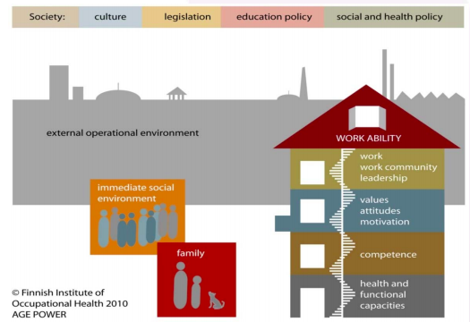
Workability
Ilmarinen, J. (2012) Promoting active aging in the workplace. Bilbao: European Agency for Health and Safety, Available at: http://www.ipbscordoba.es/uploads/Documentos/promoting-active-ageing-in-the-workplace.pdf (accessed 11 November 2018)

Slide 5

Design a Programme to Promote Health for employees to Age Well at Work

Slide 6
Health Promotion across the working life-course for Healthy Aging (Tristi’s List)
Promotion of Intergenerational Learning
Active lifestyle at work avoiding sedentary practices
Healthy Eating
Strengthening exercises/resistance training
Encouraging employees to have regular check ups e.g. health checks, eye tests, cholesterol etc.
Promote recovery between shifts
Break down stigma and discrimination – age positive culture
Promote Active Aging (see next slide)
Develop positive psychosocial environment
Development of sense of personal competence and skills acquisition
Organise work environment activities to be adaptable to individual needs and capabilities (flexibility)
Ensure that work place does not contribute to ill health
Ensure that job design does not adversely affect health
Support all employees to plan ahead from mid-life, including career and personal goals, relationships and caring responsibilities, wellbeing, health and finance.
Apply all measures to all employees as chronological aging is inevitable!

Slide 7

Developing thinking from last weeks’ Class Activity
Was your approach top down (authoritative) or bottom up (negotiated)?
Was it inclusive?
What resources would it require?
How could you engage people into this activity?
What are the barriers to participation?
What skills do you need to make this happen?

Slide 8
Directed Study week 7
1. What models and theories can you draw upon to support your approach to health promotion across working life?
2. What are the challenges that a workplace health promoter might face in delivering change?

Slide 9
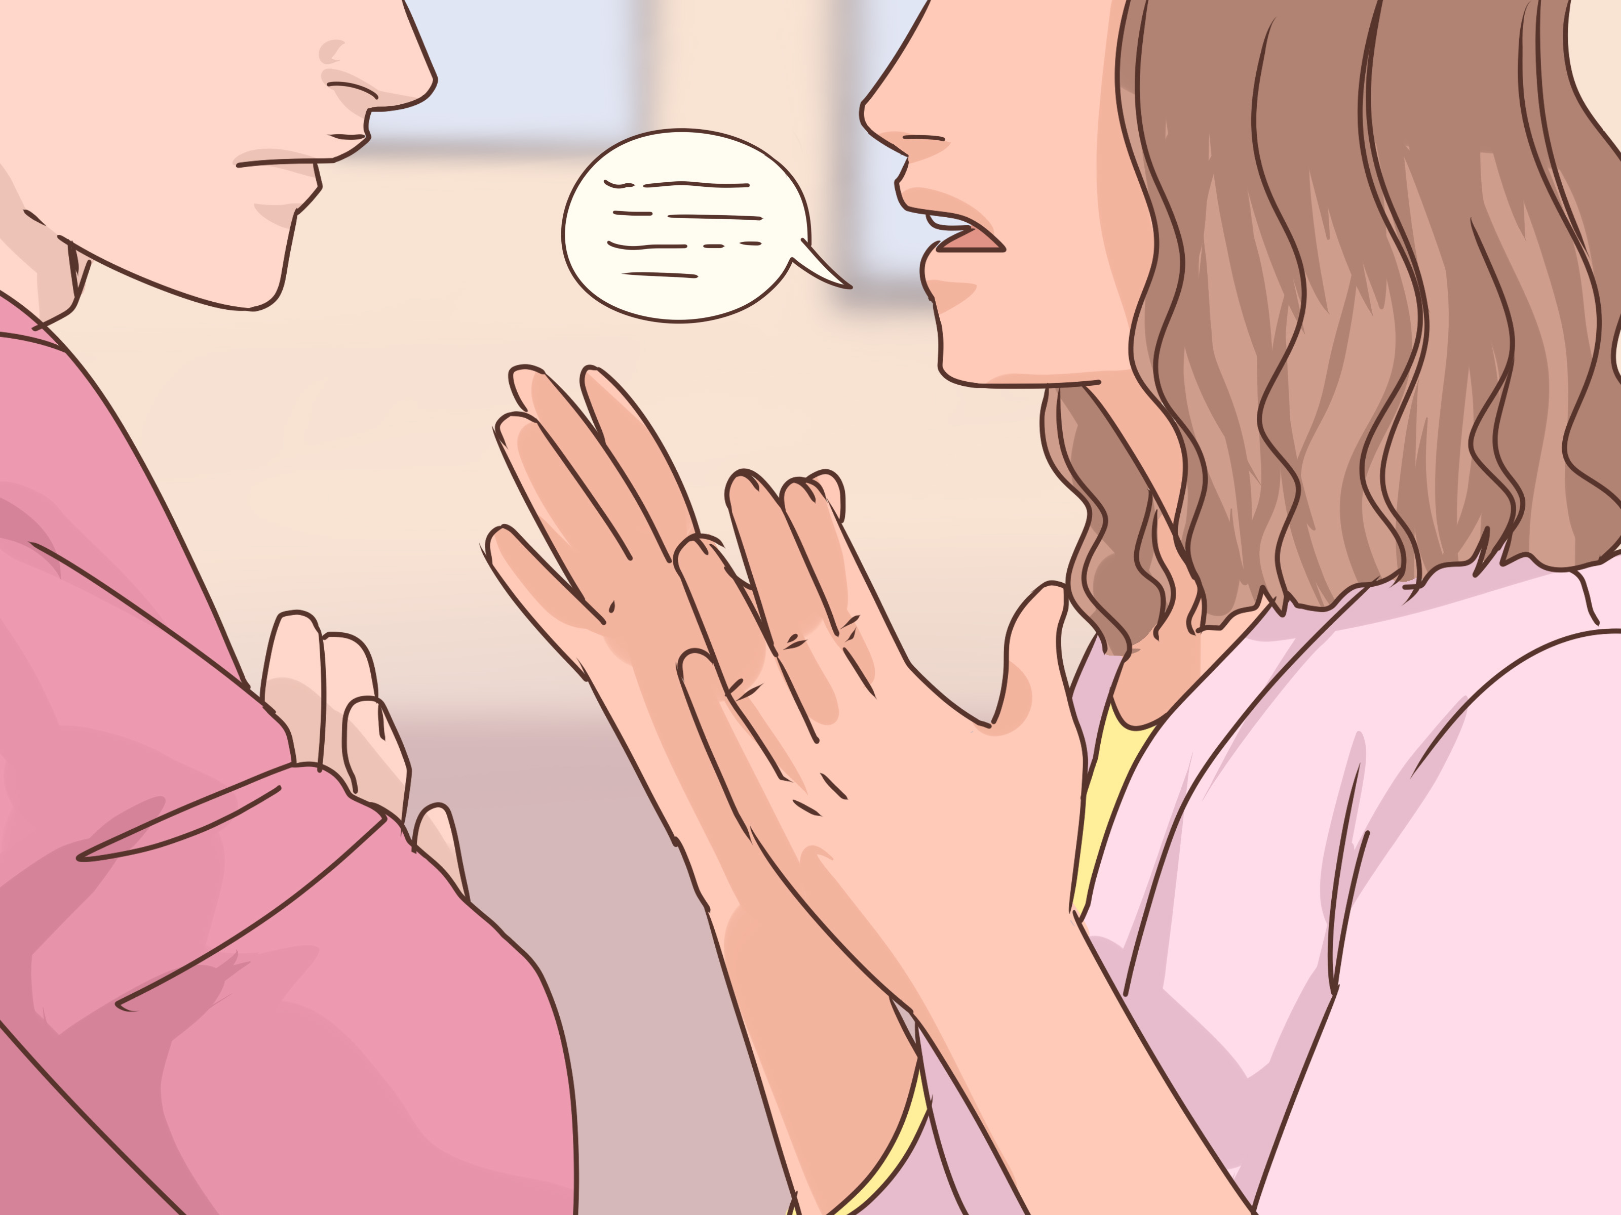
Vulnerable Groups

Slide 10

What does vulnerable mean?

Slide 11
Year 2 Recap: Vulnerability
“Vulnerability is susceptibility to any kind of harm, whether physical, moral or spiritual, at the hands of an agent or agency.”
(Little et al., 2000)
Little, M., Paul, K., Jordens, C. F. C., & Sayers, E.-J. (2000) ‘Vulnerability in the Narratives of Patients and their Carers: Studies of Colorectal Cancer’, Health, 4(4), pp. 495–510. doi: 10.1177/136345930000400405.

Slide 12
Vulnerable workers (HSE)
HSE defines vulnerable workers as those who are at risk of having their workplace entitlements denied, or who lack the capacity or means to secure them.
Health and safety should not be used as an excuse to justify discriminating against certain groups of workers.

Slide 13
Vulnerable groups in the workplace
Pick one of these groups and examine why the might be at vulnerable.
New and Expectant mothers
Disability
Age
Being new to the job
Migrant Workers

Slide 14
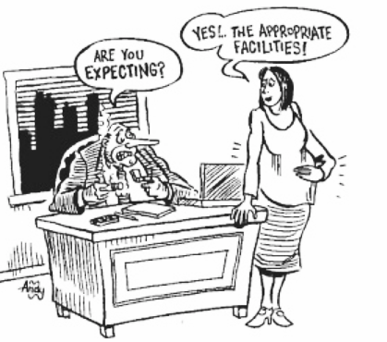
New and Expectant Mothers
Covered in by specific legislation
At risk from work processes at different stages:
lifting/carrying heavy loads
standing or sitting still for long lengths of time;
exposure to infectious diseases
exposure to lead;
exposure to toxic chemicals
work-related stress
workstations and posture
exposure to radioactive material
threat of violence in the workplace
long working hours
excessively noisy workplaces.

Slide 15
Disability
Definition of disability under the Equality Act 2010.
“...a physical or mental impairment that has a 'substantial' and 'long-term' negative effect on your ability to do normal daily activities.”
Will depend on the nature of job and the nature of the disability
Risk assessment is essential

Slide 16

Migrant Workers
Communications
Cultural attitudes
Inexperience in the context
Trained at a different level/competency
Unfamiliar with British legislation
Health status

Slide 17

Age
We considered older workers and aging population last week
Young people/young person (under 18)
Less experience
Not previously been in a workplace
Risk perception is reduced
Need training and supervision
They might not yet be physiologically or psychologically capable
Exposures may be more significant
Different rights in law especially to work and working hours
Not allowed to work in construction
See government guidance on rest breaks: https://www.gov.uk/rest-breaks-work/young-workers

Slide 18

Being new to the job
At much higher risk of work place injury due to:
lack of experience of working in a new industry or workplace
lack of familiarity with the job and the work environment
reluctance to raise concerns (or not knowing how to)
eagerness to impress workmates and managers.
New workers or those new to the site:
may not recognise hazards as a potential source of danger
may not understand 'obvious' rules for use of equipment
may be unfamiliar with site layout - especially where site hazards may change from day to day
may ignore warning signs and rules, or cut corners
New workers may also have other vulnerabilities

Slide 19
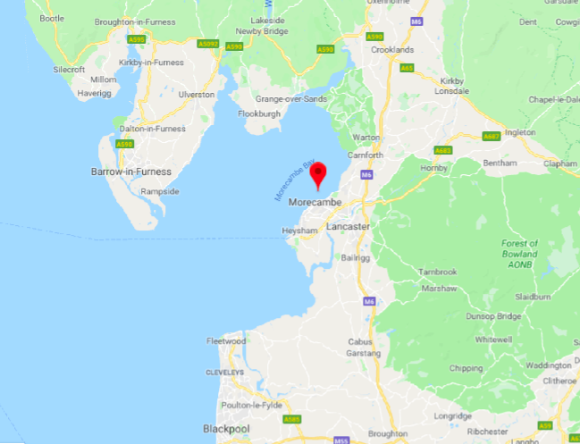
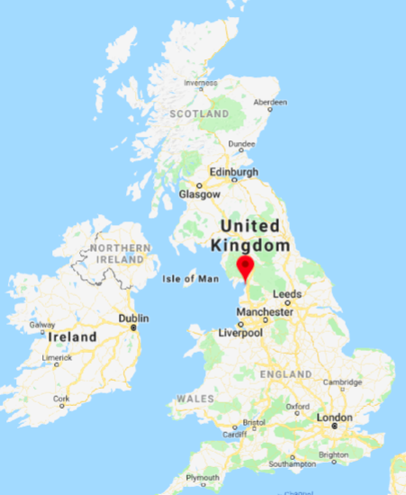
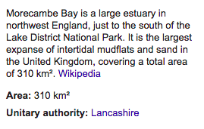

Cockle Pickers – Morecambe Bay 2004
https://www.bbc.co.uk/news/uk-england-25914594

Slide 20

Modern Slavery
10,000 and 13,000 potential victims of modern slavery in the UK in 2013 (HM Government Annual Report on Modern Slavery, 2018)
Modern Day Slavery Act, 2015
Companies must eradicate slavery from their supply chain
See Exten-Wright, J. (2015)’How employers can prepare for the modern slavery act. Personnel Today, https://www.personneltoday.com/hr/employers-can-prepare-modern-slavery-act/ (accessed 17 November 2018)

Slide 21
Modern Day Slavery Act, 2015
Slavery takes many forms and can be found in different situations e.g. domestic situations - kept in servitude or sexually exploited.
Criminal gangs may forcibly recruit vulnerable people.
In the workplace, there are two forms of modern slavery.
The first is debt bondage - individuals are forced to work to pay off debts that they have little hope of ever paying off. For example, debts may be accrued through having to “rent” machinery or equipment they need to do the work or accommodation, for example.
The second form is forced labour, in which people are made to work for little or no pay under the threat of deportation, violence or something else that compels them to stay.

Slide 22
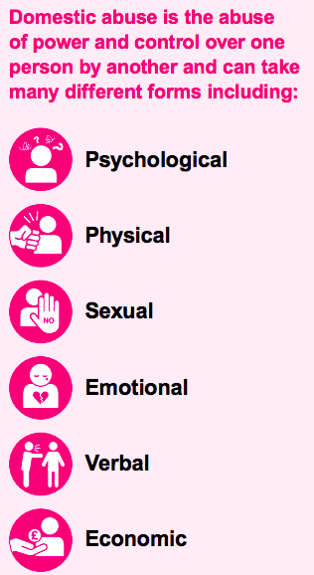
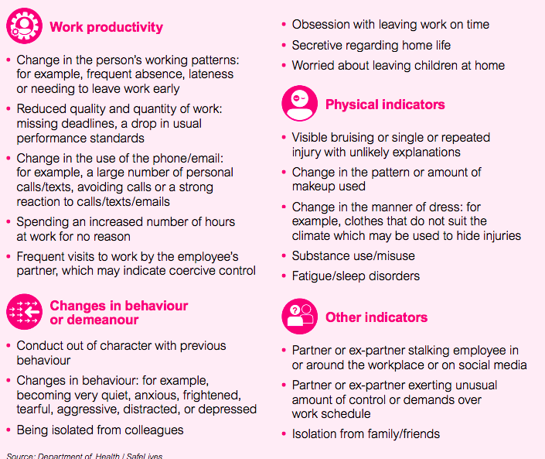
Domestic Abuse
“An estimated 1.9 million adults aged 16 to 59 experienced domestic abuse in the last year. Two women each week and one man each month are killed in England and Wales by a current or former partner.”
Raise Awareness
Reduce Stigma
Signpost support
See BITC toolkit on [Bb]

Slide 23
Directed Study Neurodiversity
In preparation for week 10 - Find out about neurodiversity and how this can impact on health and employment use the following websites to support you:
CIPD https://www.cipd.co.uk/knowledge/fundamentals/relations/diversity/neurodiversity-work
National Autistic Societyhttps://network.autism.org.uk/knowledge/insight-opinion/neurodiversity-workplace
Read Robertson, M.S. (2012)’ Neurodiversity, quality of life, and autistic adults: Shifting research and professional focuses onto real-life challenges’, Disability Studies Quarterly, 30 (1)[online] available at: http://dsq-sds.org/article/view/1069/1234 (accessed 17 November 2018)

